Slide 1

Employee Retention Analysis – By Joseph Thomas

Slide 2
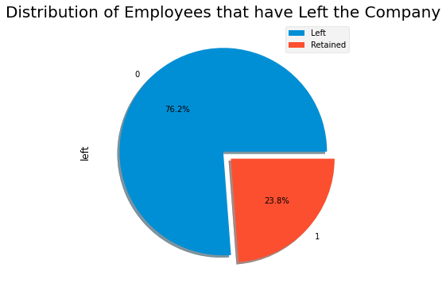
The Employee Retention Problem
The data shows that there is an alarming rate of employee departure - with nearly a quarter of employees choosing to work elsewhere.
The purpose of this presentation is to:
Understand why employees are leaving
Predict the likelihood that an employee will leave
Devise a solution to improve employee retention
This report begins by understanding which employees are leaving the company…

Slide 3
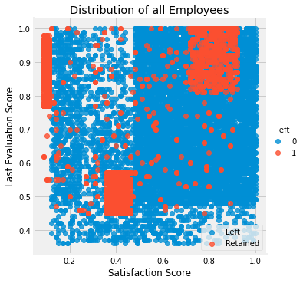
Who Is Leaving?
By plotting each employee based on their ‘Last Evaluation Score’ and their recorded ’Satisfaction’ with the company we can see that most of the employees that are choosing to leave belong to three distinct groups:
Poor Performing and Unhappy: This group (Middle) scored low on both their last performance and in their satisfaction at the company
High Performing and Unhappy: This group (Top Left) scored very well in the last performance evaluation but are incredibly unhappy
High Performing and Happy: This group (Top Right) scored highly on both their last performance and are very happy working at the company

Slide 4



Understanding the Employee Clusters
Each cluster of employees provides different possible reasons as to why they are choosing to leave…
Poor Performing and Unhappy: Are struggling employees provided with sufficient support?
High Performing and Unhappy: Are employees content with their responsibilities?
Poor Performing and Unhappy: Are struggling employees provided with sufficient support?
Let’s analyse the data to find answers to these questions...

Slide 5
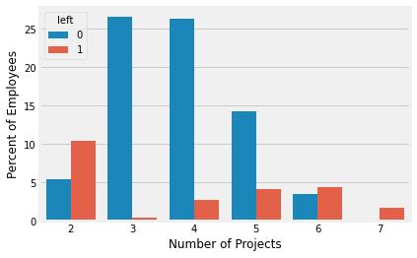
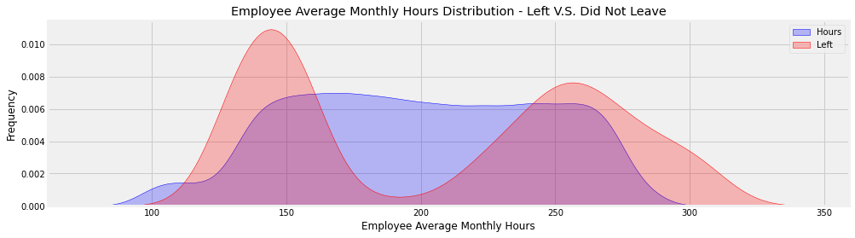
Are employees' content with their responsibilities?
There are a large number of departing employees that are high-performing but unhappy. This raises the question…are the best employees being overwhelmed?
Next, let’s examine the relationship between the hours employees work and departure rates:
This Kernel Distribution plots the employee’s Average Monthly Hours and Leaving Rates.
First let’s analyse the relationship between the number of projects employees are given and employee departure:
This chart shows that employees being given 2, 6 and 7 projects are making up most of the departures.
This would suggest that employees that are both underwhelmed and overwhelmed with their responsibilities are leaving the company at greater rates.
The bimodal nature of the leaving distribution (red) shows that the most employees are leaving when they are working more hours and less. This supports our findings from examining the number of projects employees are given…

Slide 6
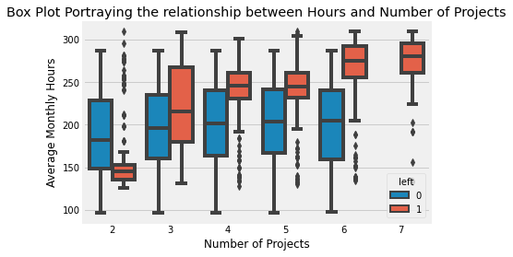
Are employees' content with their responsibilities?
To extend this analysis, let’s now examine the relationship between the average monthly hours worked and the number of projects an employee is given:
We can see that employees are staying at greater rates when the number of hours they work remain consistent as the number of projects varies.
Employees are leaving at much greater rates when they are given more projects that also increases the hours that they are working.
It is therefore likely to assume that high-performing employees being trusted with a greater number of projects are in-turn being overworked, driving their desire to move companies.
We can also see that employees that are given 2 projects and working less than 150 hours a month are also leaving. Having more information on why employees leave would allow us to verify if this is employees leaving due to lack of responsibility, or if they are being let go.

Slide 7
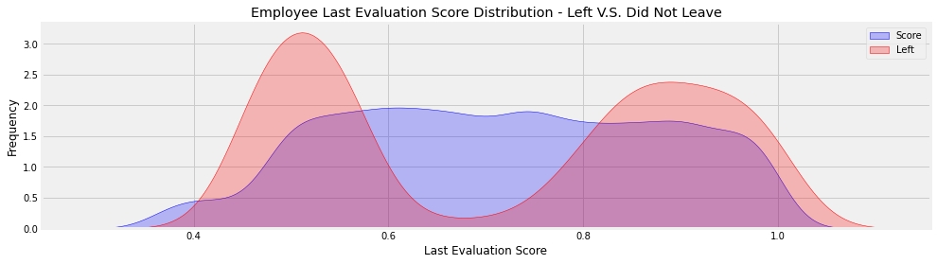
Are Employees Supported?
There are a large number of departing employees that are both performing poorly and are unhappy. This raises the question…are employees receiving sufficient support?
The Kernel Distribution above is another example of bimodal distribution that shows that the largest peak in employee departure rates occurs with unsatisfied employees.
This could be a strong indication that employees that are unhappy and struggling to work at the company are not being identified and not enough support is being given to them that would help to improve their experiences at work. Such an intervention would also be a vital opportunity to learn how working conditions at the company could be improved.

Slide 8
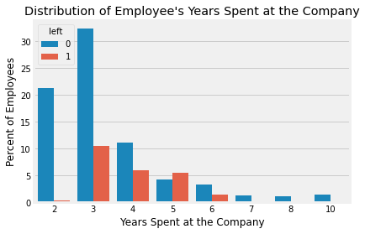
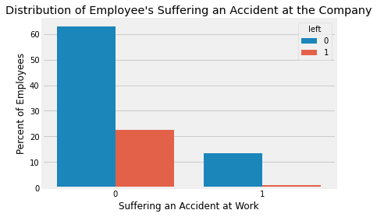
Are Employees Supported?
To further assess the support employees receive, lets analyse some features that could give us more information:
Summary
It is clear that employees that are underperforming are leaving at much higher rates than those with evaluation scores between 0.6 and 0.8
This is a clear signal that struggling employees need more support and training to improve their quality of work
Employees are leaving, mostly, after spending 3-5 years at the company – a sign of a welcoming onboarding and positive environment for more settled employees
Safety conditions need to be improved
Employees that have suffered are receiving positive welfare support which is reflected in the small percentage of such employees leaving
First, let’s first look at the relationship between the number of years spent at the company and employee departure rates:
Next, let’s first look at the relationship between work accidents and employee departure rates:
It is firstly alarming that nearly 15% of employees have suffered an accident at the company. This suggests that working conditions and safety are an issue that need to be addressed and improved upon.
It is also evident that of the employees that have suffered an accident, almost all of them have stayed at the company. This implies that these employees were well looked after and felt safe enough to return to work
Almost no employees leave in their first two years at the company – a sign of a welcoming, supportive onboarding process. Employees in the range of 3-5 years have significantly elevated leaving numbers – likely due to employee’s naturally progressing in their own careers.

Slide 9
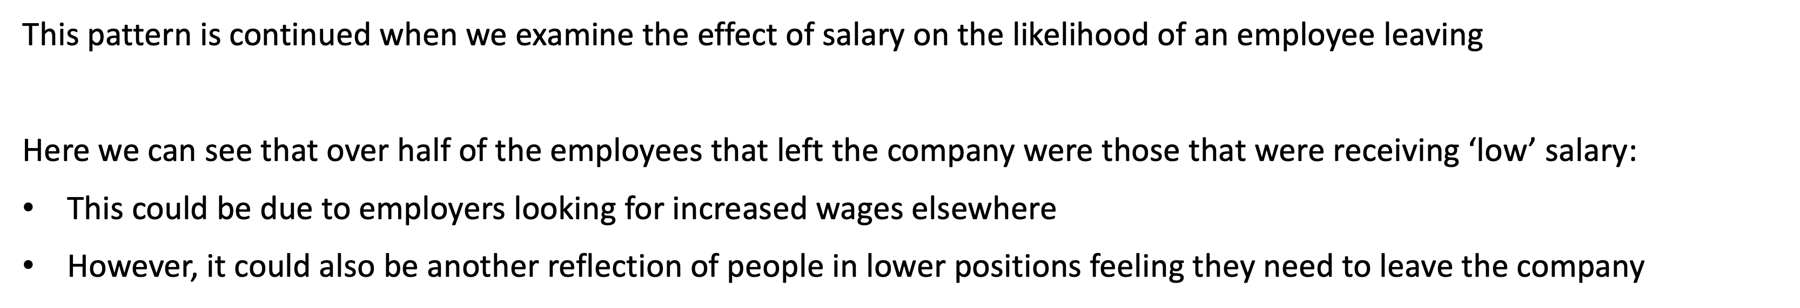
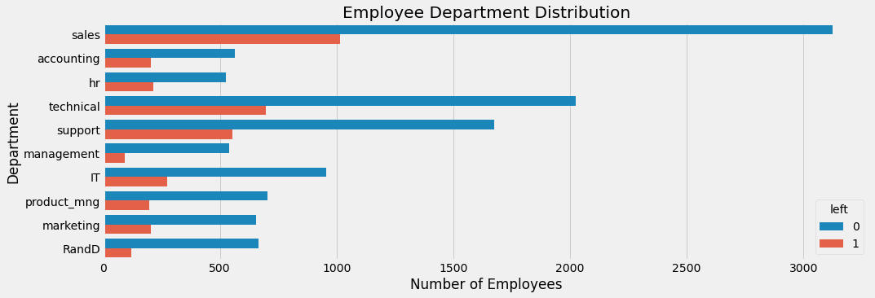
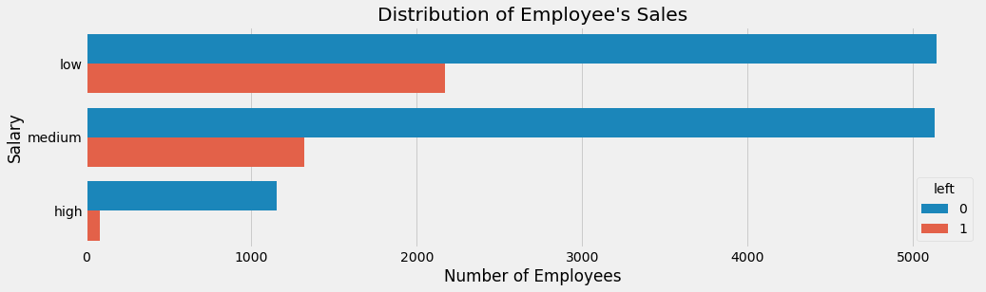
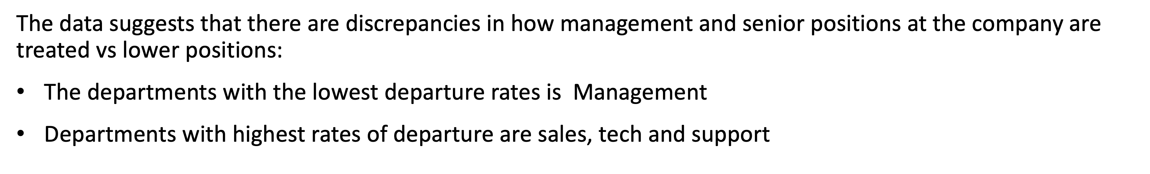
Scrutinizing company culture
There are a large number of departing happy, high-performing employees that are leaving…one possible reason is the company culture…

Slide 10
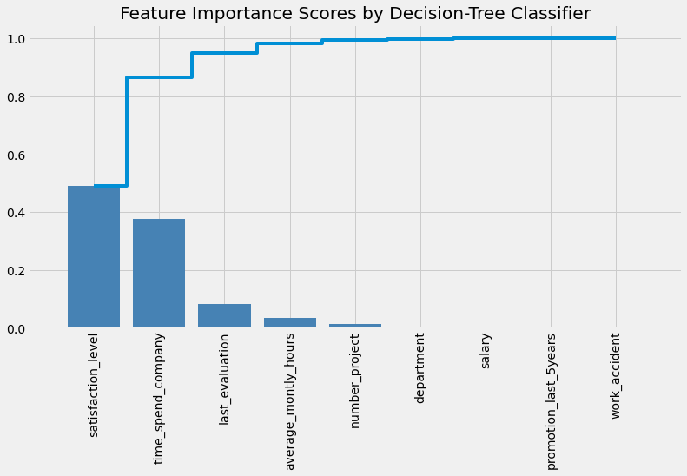
What are the most important features driving employees to leave?
Whilst our analysis can show us how the various features relate to employees leaving, by running a ‘Decision-Tree Classifier Feature Importance’ allows us to rank each of the variables to see which are the most influential in driving an employee to leave:
The most important features are:
Employee Satisfaction
Time Spent at the Company
Last Evaluation Score
Average Monthly Hours
Number of Projects
It is no surprise that employee satisfaction and time spent at the company are by far the most important .
The following three support our analyses suggesting that employees that leave are often overworked and are either performing badly, or very well

Slide 11
Predicting Employee Departure
We can use a Machine Learning classification technique called ‘Logistic Regression’ to produce an equation that will allow us to group employees based on the likelihood that they will leave the company…
Logistic Regression uses a function that assigns a probability that an entry belongs to one category or another. This is, in part, done by assigning weights to each of the features that make up an entry.
In the classification executed here the four most important features for determining employee departure, and were attributed the following coefficients (weights):
Feature | Coefficient
Satisfaction Rating | -3.557825
Time Spent at the Company | 0.171361
Last Evaluation | 0.203143
Average Monthly Hours | 0.001705
Intercept | -0.275524
These coefficients can be used to create an equation that will allow us to classify employees based on the probability that they will leave the company…

Slide 12
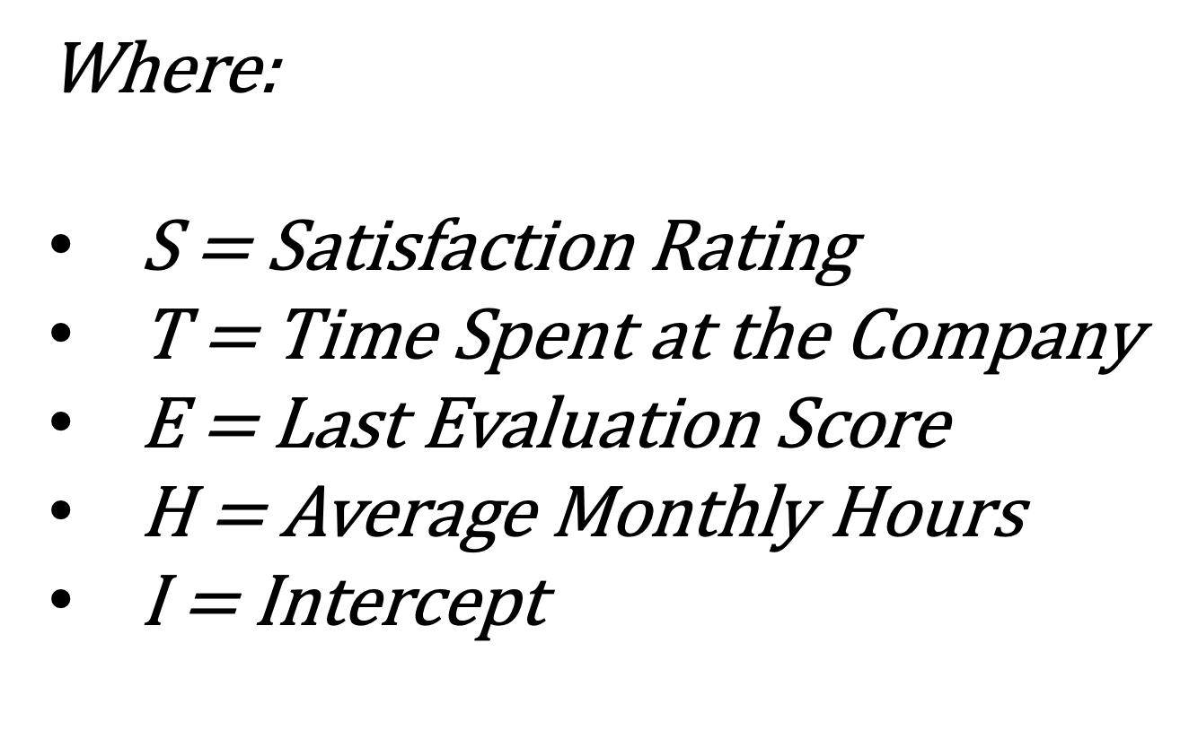
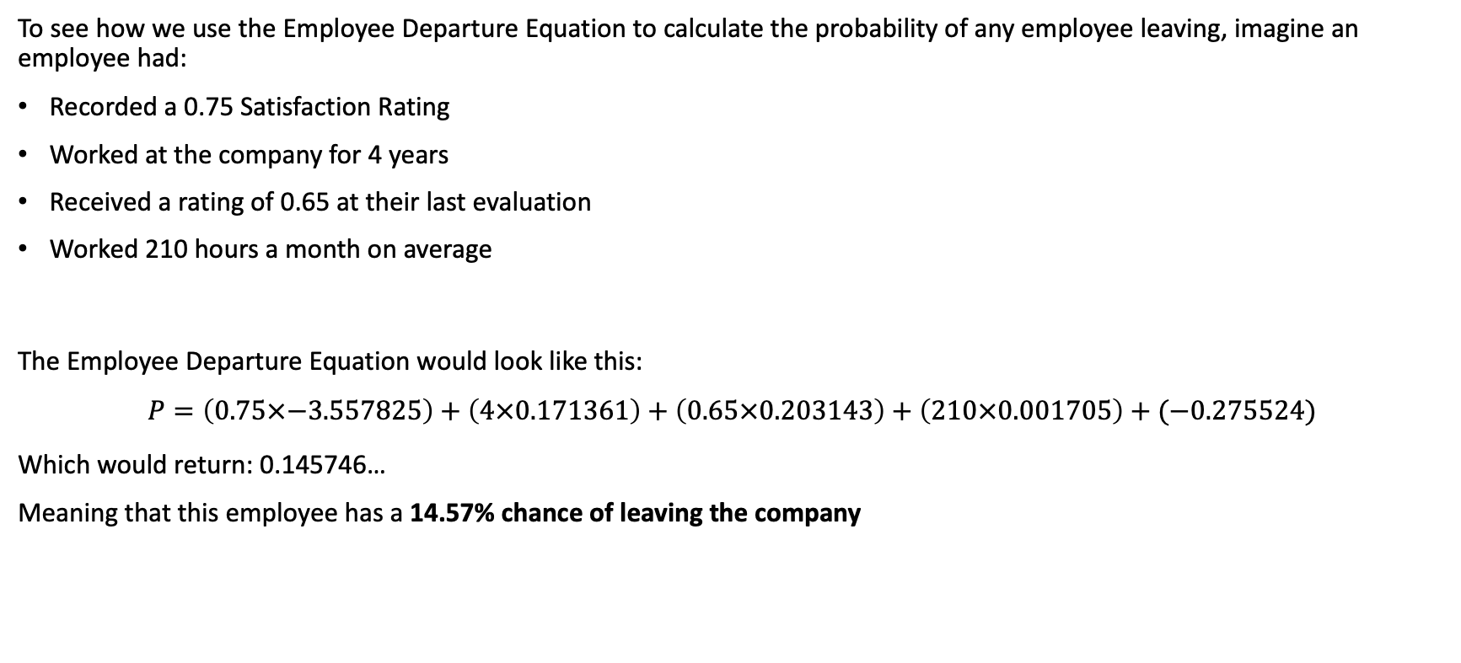
The Employee Departure Equation
Using the coefficients obtained from the Linear Regression we can deploy the following equation:
$$Probability of Departure=S\left(−3.557825\right)+T\left(0.171361\right)+E\left(0.203143\right)+H\left(0.001705\right)+I$$
To see how we use the Employee Departure Equation to calculate the probability of any employee leaving, imagine an employee had:
Recorded a 0.75 Satisfaction Rating
Worked at the company for 4 years
Received a rating of 0.65 at their last evaluation
Worked 210 hours a month on average
The Employee Departure Equation would look like this:
$$P=\left(0.75×−3.557825\right)+\left(4×0.171361\right)+\left(0.65×0.203143\right)+\left(210×0.001705\right)+(\text{−0.275524}\text{)}$$
Which would return: 0.145746…
Meaning that this employee has a 14.57% chance of leaving the company

Slide 13
Using the Employee Departure Equation Output
By categorising the employees in this manner, management can monitor those which are showing potential for leaving, but also quickly intervene to help employees that are showing dangerously high signs of leaving the company
The Employee Departure Equation will produce the probability that each employer will leave the company. By evaluating these probabilities, we can place each employee into a group based on their scores.
Safe – Employees within this zone are considered safe (Score ≤ 10%)
Low Risk – Employees within this zone show small potential for leaving (10% < Score ≤ 40%)
Medium Risk – Employees within this zone show moderate potential for leaving (40% < Score ≤ 70%)
High Risk – Employees within this zone are considered to have a high chance of leaving (70%+)

Slide 14
Summary
Solutions to the Employee Departure Problem:
Solution 1
With the Employee Departure Equation, we now have a mechanism by which we can rank employees by their probability of leaving.
We can use these groupings and allocate a limited incentive budget to the highest probability instances
Solution 2
We can develop a system to monitor the hours and responsibility given to an employee to prevent the effects of working excessive hours – likely overwhelming the best employees
Solution 3
Introduce a survey system that allows management to understand how the work conditions are affecting their employees. By flagging individual opinions, we can generate more accurate answers to the questions raised by the analyses:
Are employees' content with their responsibilities?
Do the employees feel supported?
Do management need to address the company’s culture?
From all of the analysis reported here, the company’s employees can be clustered into distinct groups that generally leave when they:
Are working excessive hours, especially those working over 250 hours a month
Are not working enough hours, especially those working less than 150 hours a day
Score really high, or low, in their recent evaluations
Have salaries categorised as low
Are given 2, 6, or 7 projects to work on
Have spent between 3 and 5 years at the company
We also know that the most important factors in determining an employee's likelihood of departure are Satisfaction, Years at the Company, Average Hours and Last Evaluation scores.

Slide 15

To Aid Future Analysis
Improving the retention of employees is a continuous process that will need to be revisited frequently. In order to maximise the impact data analysis can have on future reports, some suggestions for improved data collection would be to include:
Gender Variable
Distance Travelled to Attend
Number of Previous Employers
Years with the Current Manager
Reason for Leaving
These variables are examples of additions that would enrich the data available for analysis and allow our predictions for departure probability to be further enhanced.

